Slide 1
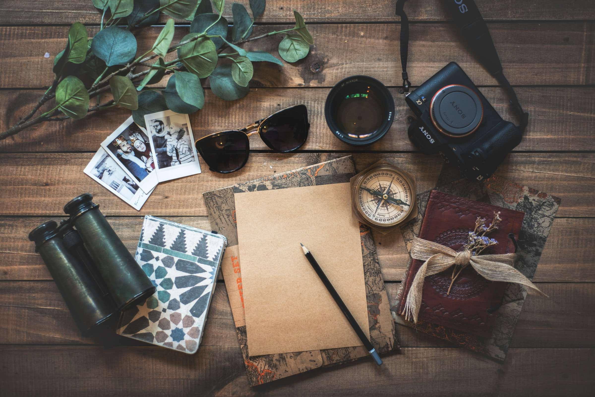

Our Favorite Vacations
By Students of Hogwarts

Slide 2
Team Introduction
Tiffany
Chuck
Lori

Slide 3
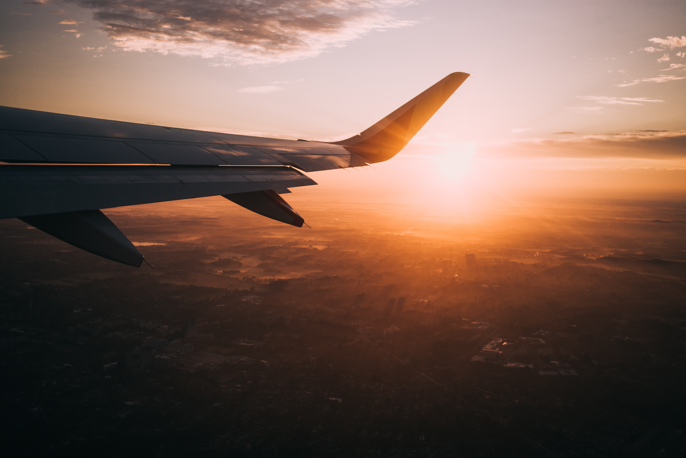
Agenda
Our Website Idea
Challenges
Learnings
Short Retrospective
Dreams of Betterment

Slide 4
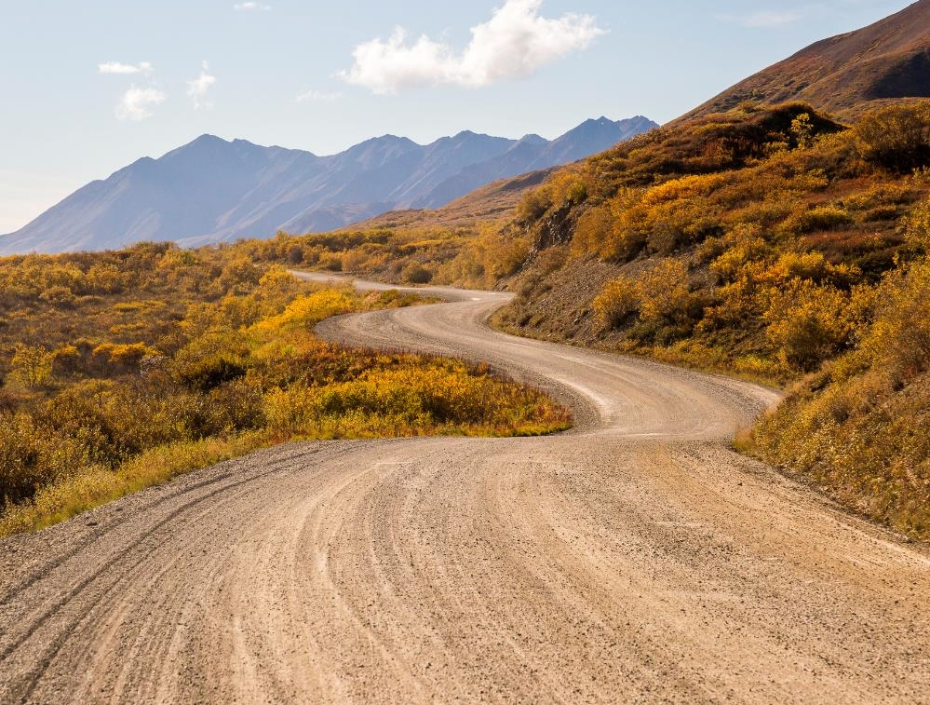
Our Website Idea
A website to highlight our favorite vacations.
Notes:
When thinking about what we wanted to do for the website, we all said vacations or travel at the same time.
Funny Story ~ When deciding what location each of us would highlight, Chuck said he wanted to do Disney and Tiffany said SHE was planning to do Disney. So, then Tiffany said she was going to do Colorado and Lori said SHE was planning to do Colorado. So poor, poor Tiffany was the hero and settled on San Diego.

Slide 5
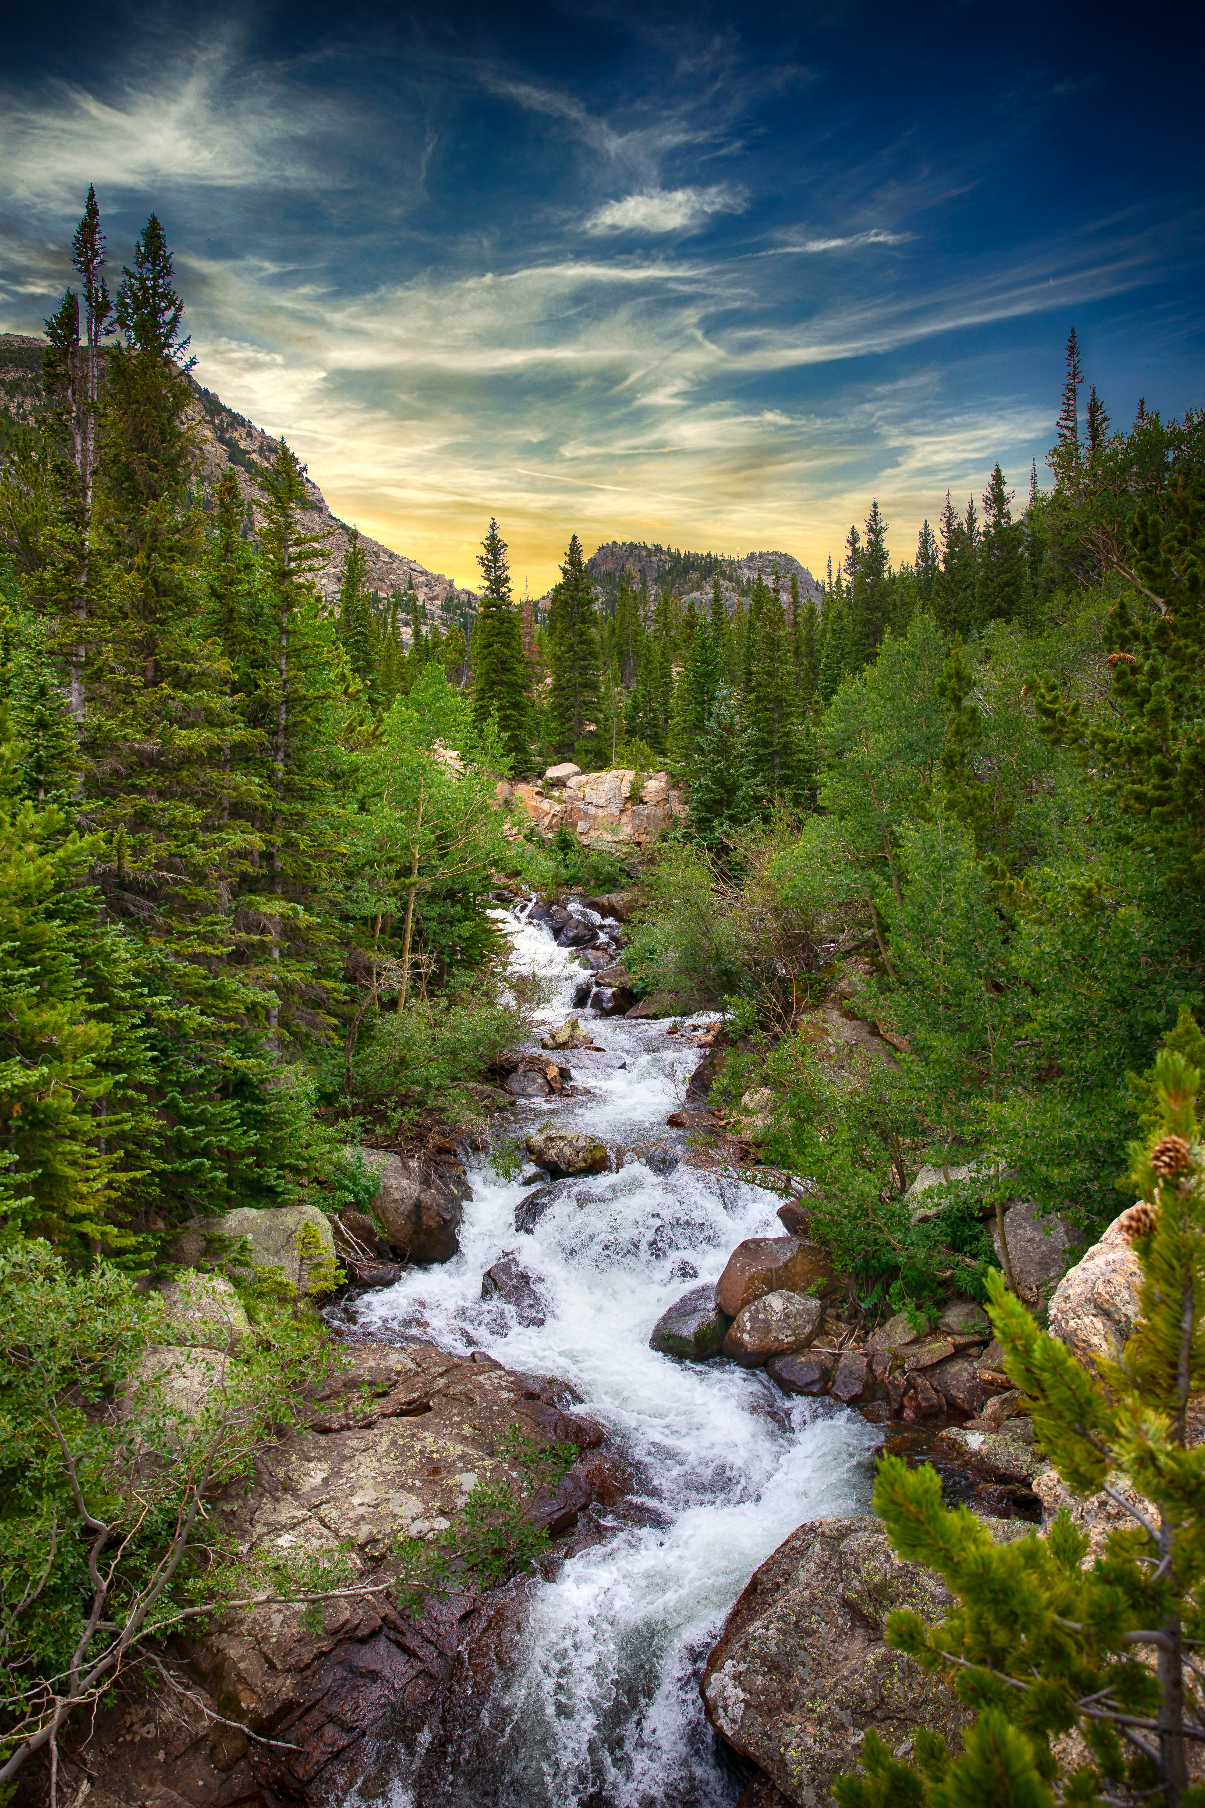
Challenges
CSS can cause issues when sizing and picture placement​.
CSS can be troublesome if not organized.
Live share in VS Code seemed to present some issues when it come to multiple people attempting to make changes.
Lori’s new but possessed laptop... with the ever present, unwanted contributor…

Slide 6
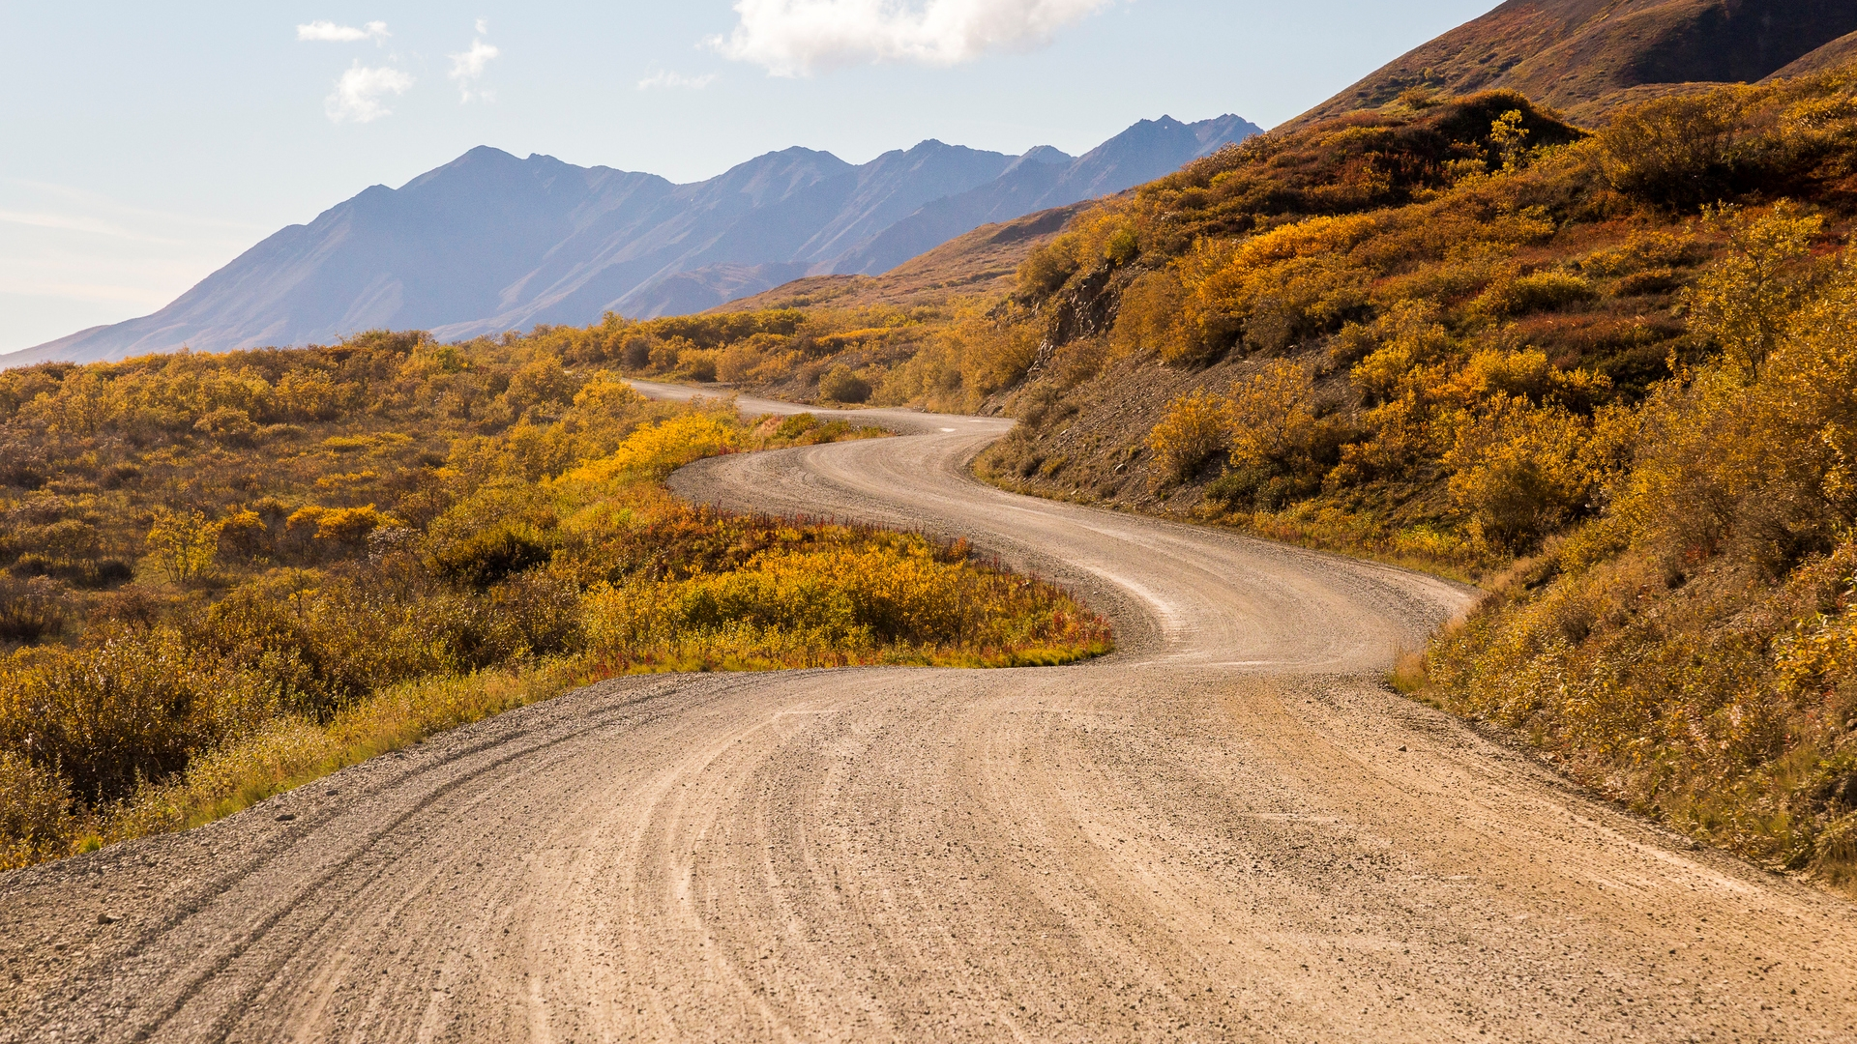
The way to get started is to quit talking and begin doing.
Walt Disney

Slide 7
Learnings
Chuck
Tiffany
Lori
​Continued learning DOM manipulation experiences
Application of learned skills using DOM. Add transitions, animations, and motion
Applying a filtering process for images
How to create an image slideshow
Website preview when hovering over a link using the iframe tag
CSS organization is important
Embedding vide​o and other media
GitHub merge conflict resolution
To prevent malicious attacks from linked pages
The difference between GitHub and GitLab
Notes:
Chuck - bullet 2 - when creating a way to magically generate a message to the user once a form is completed.
Tiffany – bullet 3 – class vs id – id takes precedence over class.
Lori – bullet 1 – embedding the background and video

Slide 8
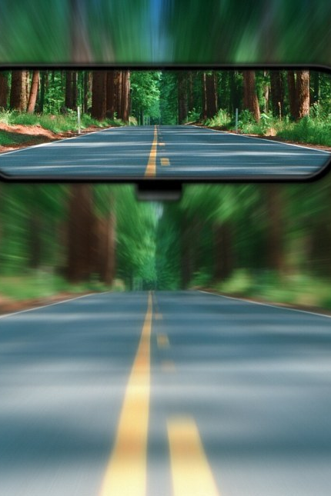
Short Retrospective
Better organization of the code
Approach to styling
More organized on how to apply
Get best practices ahead of time
Notes:
Lori – style in a more organized way so as not to affect other elements.

Slide 9
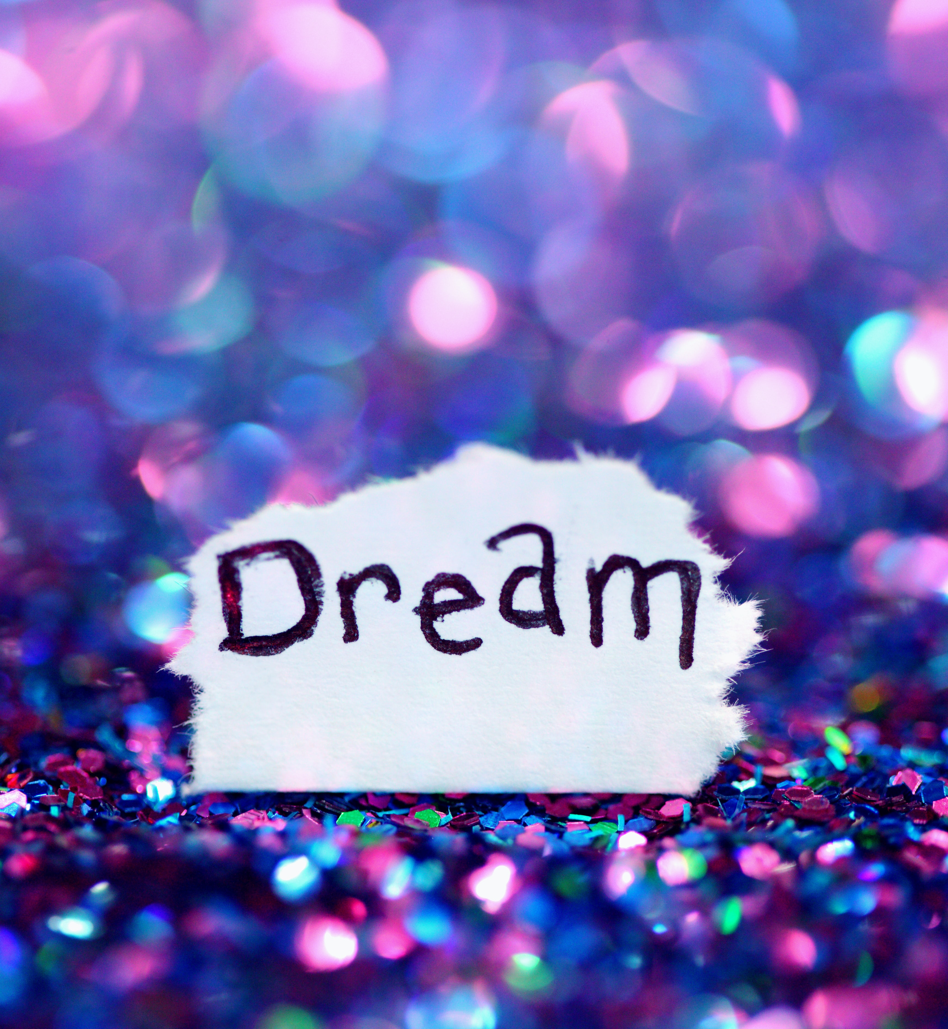
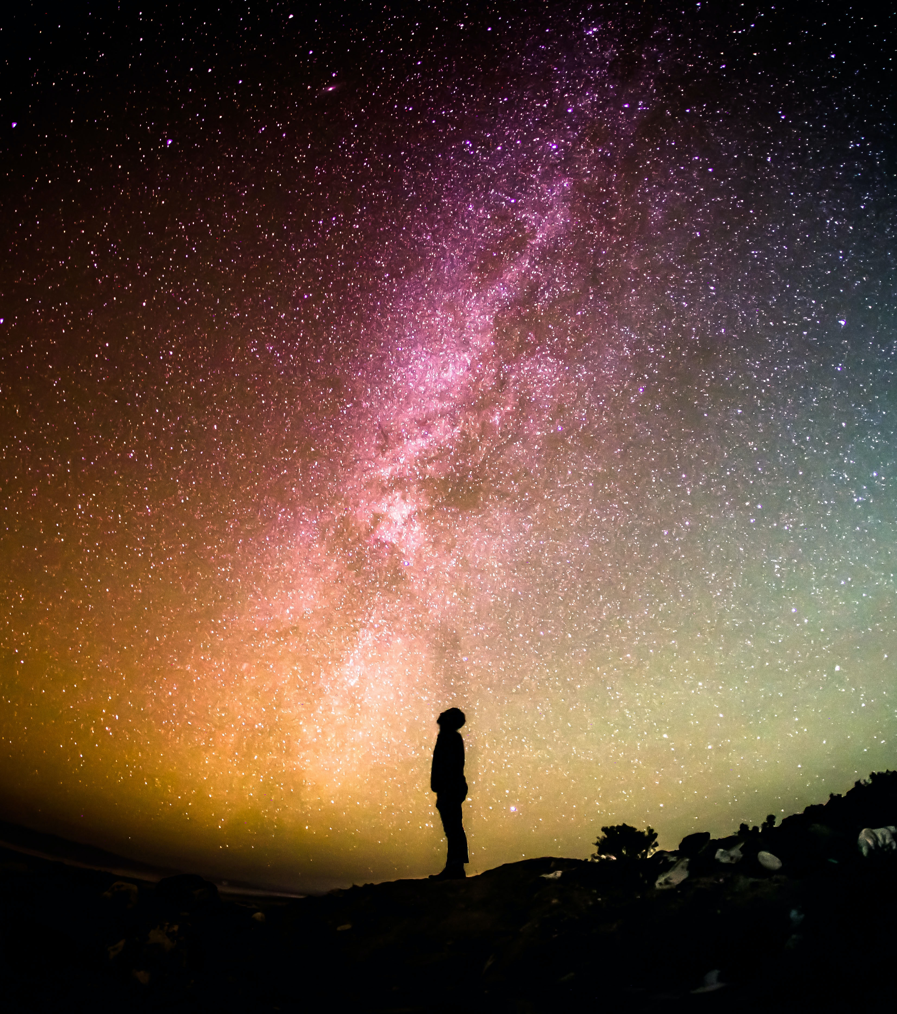
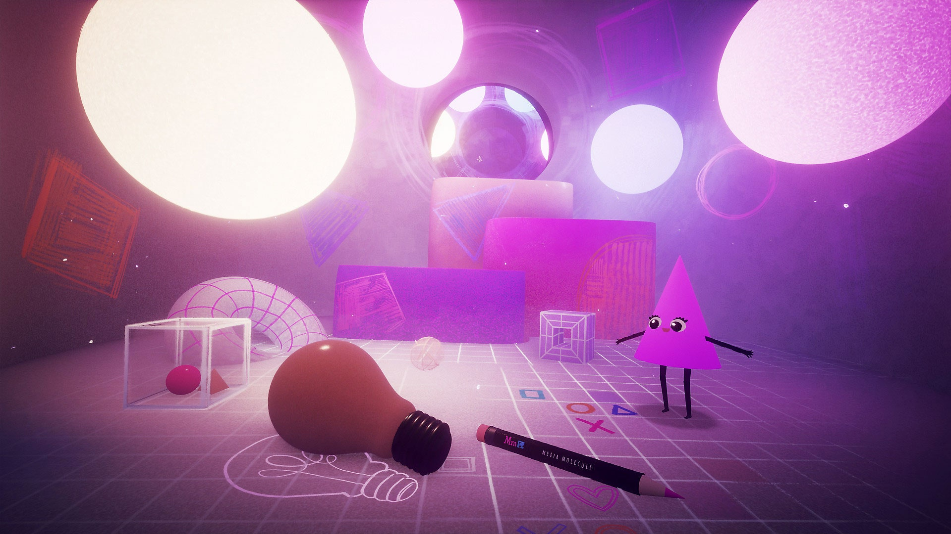
Dreams of Betterment
Add more personal touches
Update submit button to provide for selected location:
Images
Link to events or top 5 things to do
Add images based on the type of weather.
Notes:
Chuck – personal images from the trip.
Images – sunny = sun… Blah blah blah

Slide 10
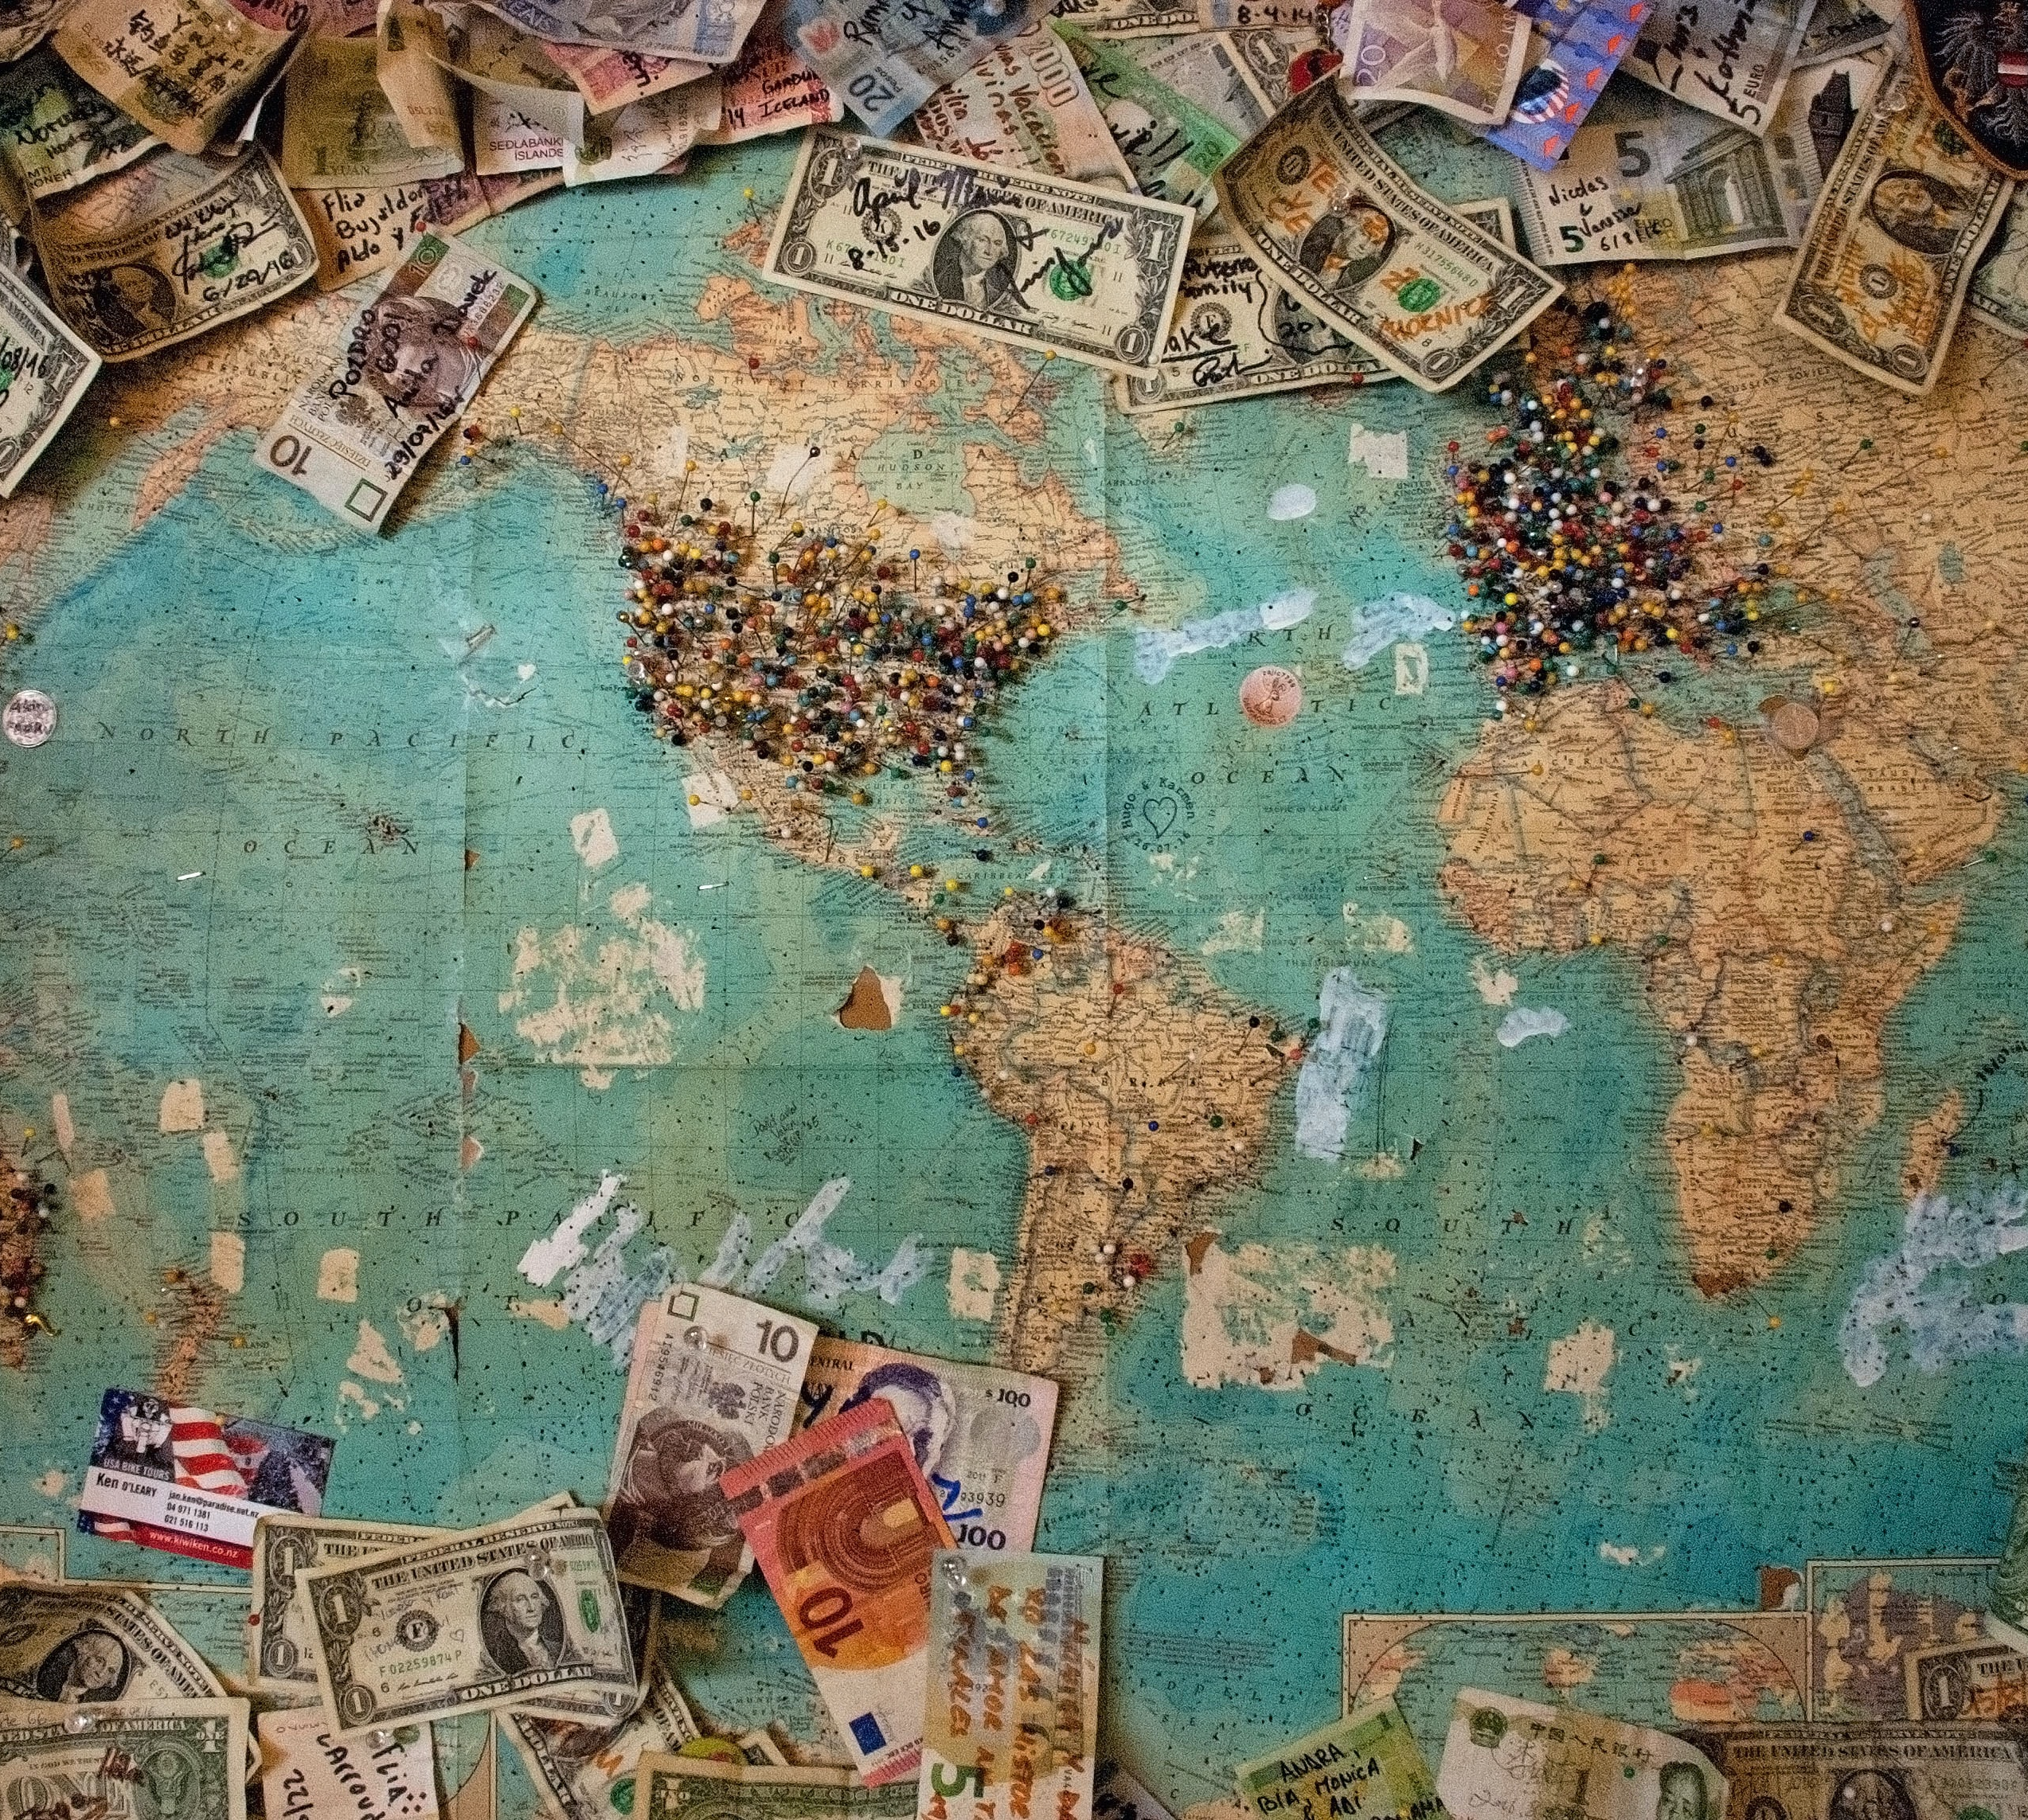
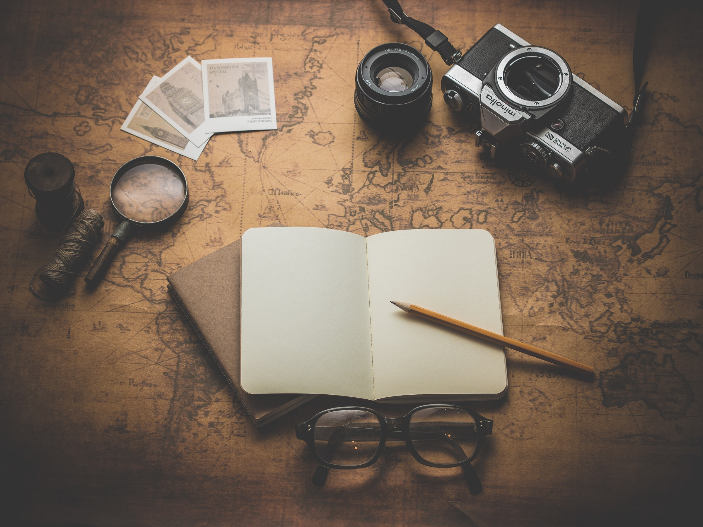
Thank you
Tiffany, Chuck & Lori
aka
The Students of Hogwarts

